Slide 1
Introduction to Cambridge Econometrics
Cambridge Econometrics training course
(presentation not to be made public)
Hector Pollitt
September 2015

Slide 2
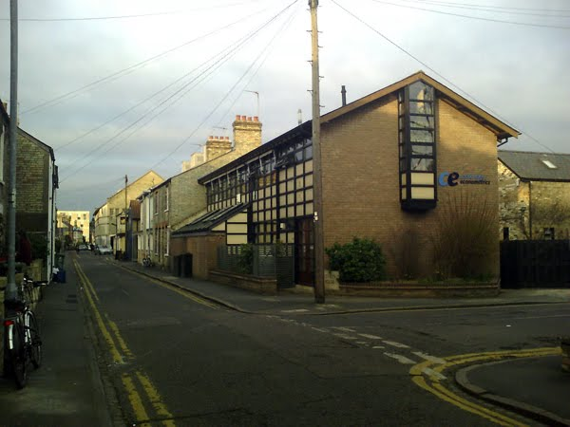
Background
Cambridge Econometrics (CE)
History
  UK forecasting
  macro-modelling
  regional modelling
  E3 linkages
  European analysis
  global analysis
https://ssl.panoramio.com/photo/34994872

Slide 3
1978 Spin-off from the University of Cambridge Department of Applied Economics
Origins in the ‘Growth Project’ led by Nobel Laureate Prof Sir Richard Stone
pioneered the development of detailed sectoral modelling in an input-output framework MDM
2003 CE 25th anniversary. Terry Barker sets up charitable trust fund to ensure CE's independence and principles.
New Thinking in Economics:
‘to advance education in the field of economics for the benefit of the public’
Early 1990s Expansion of scope of CE’s work to
European Regional
UK Energy, Environment and Economy service
More tailored project work
Company grows from 10 to 25 staff.
1975
1980
1990
2000
2010
1985
1995
2005
Early stage of the company
Product and model developments
The move to more consultancy projects
1980s CE’s work focuses mainly on annual subscription services
UK Industrial service
UK Regional service
and selected projects, notably the EC-funded HERMES project (in effect, a predecessor for E3ME)
Today 30 staff based in Cambridge. International reputation in the application of whole-economy, sectoral modelling, particularly the global E3ME model
1993 Start of part-EC funded research project to build E3ME

Slide 4
Your Presenter
Heads the International Modelling team at CE and the E3ME model
An economist by background
Leads on research/consultancy concerning:
  energy/climate policy
  resource efficiency policy
  labour market analysis and forecasting
  model review exercises
  training provision
Notes:
Mention who the main clients are

Slide 5
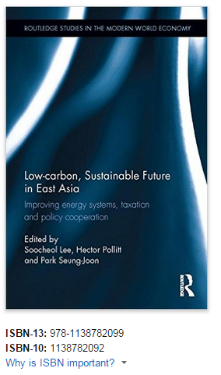
The Book…
A set of essays on future climate policy in East Asia, focusing on:
  the energy system
  Environmental Tax Reform
  Sustainable trade
Notes:
Mention who the main clients are

